Slide 1
Introducing

Slide 2
What is StaffBox Rota?
An innovative rota system designed by people within the NHS to meet the needs of current staffing issues, matching available clinical and non-clinical shifts to professionals able to work them
Covers all roles with the ability to personalise additional roles
Automated invoicing for hassle free payments
Instant alerts on available shifts
Easy to use app version with enhanced security via face and touch recognition
On the Digital Framework for Flexible Working Pools & HSJ Digital Award finalist 2023

Slide 3
How to use StaffBox Rota

Slide 4
Why are we different?
Started by One Wirral CIC
We're not an agency – ethically focused and keeping the money saved within the system
Profit margins are reinvested into addressing health inequalities on the Wirral
Use it ourselves – we too needed a program that could enable the System to take more control of addressing staffing issues with flexible working pools.
Listen to our users - our collaborative approach allows for tailored and focused development to the products

Slide 5
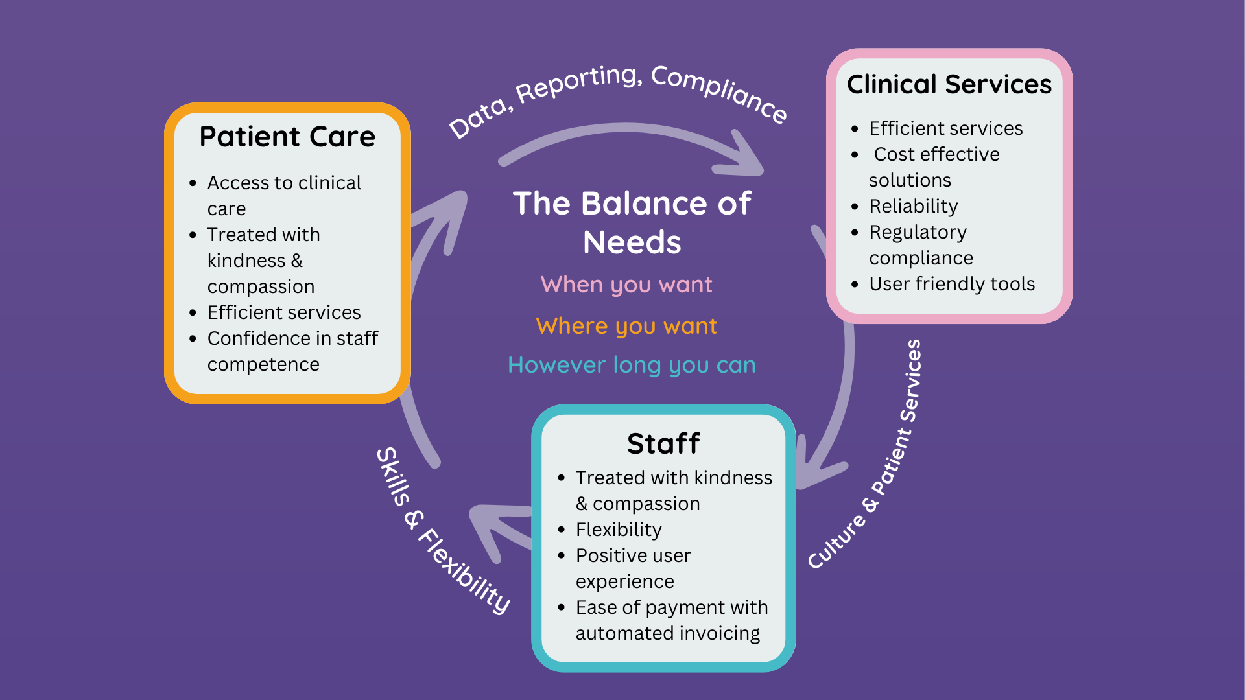

Slide 6
How we support the NHS's workforce
Helping the NHS to sustainably expand the workforce by:
Empowering staff, providing them with the flexibility and choice they need to deliver care in a time and place that suits them
Providing flexibility and choice to suit worker's preferences
Improving consistency through sharing standard operating procedures and guidelines
Ensures Regulatory compliance and record keeping
Supports NHS Policies
NHS Long Term Plan - diversification of the workforce
NHS People Plan - flexible working pools
Primary Care Recovery Plan delivery
Capacity and Access Fund delivery

Slide 7
How many people use Rota?

Slide 8
Who uses our platform?

Slide 9
Testimonials

Slide 10
Any
Questions?

